Slide 1
Comparing peak optimization values before and after the implementation of A Disaster Algorithm
Ayush Hariharan

Slide 2
Intro to Quantum Computing

Slide 3
Knapsack Problem

Slide 4
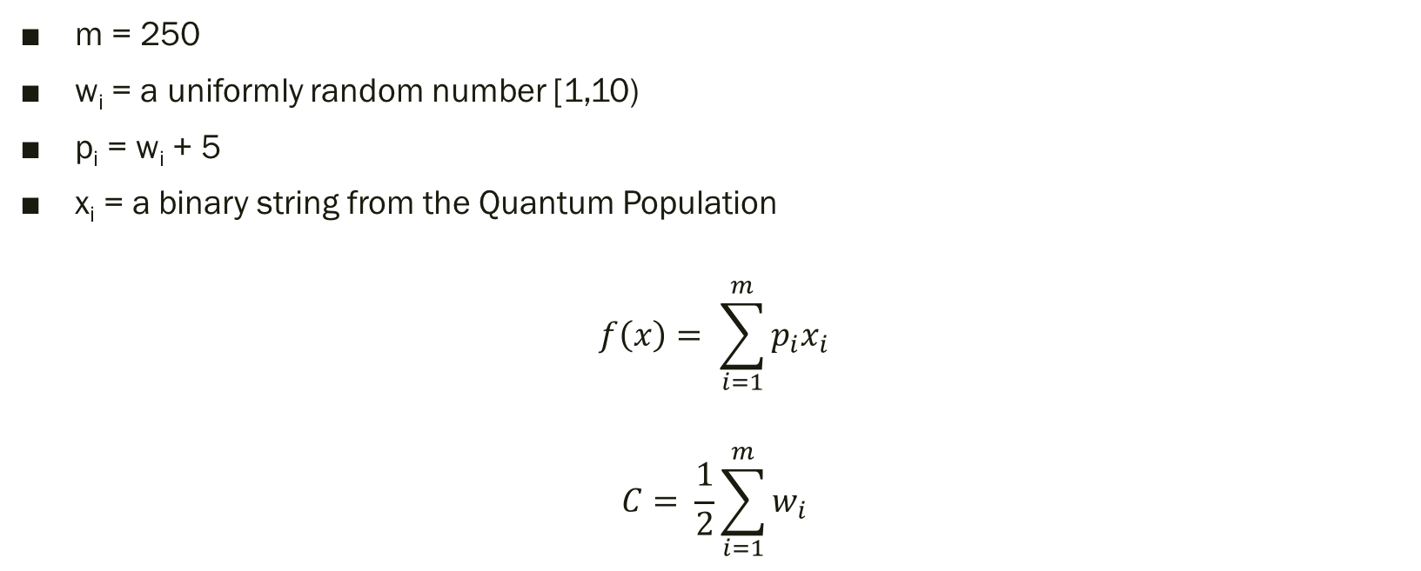
The Math Behind the Knapsack
m = 250
w_{i} = a uniformly random number [1,10)
p_{i} = w_{i} + 5
x_{i} = a binary string from the Quantum Population
$$f\left(x\right)= \sum_{i=1}^{m}{p_{i}x_{i}}$$
$$C= \frac{1}{2}\sum_{i=1}^{m}{w_{i}}$$

Slide 5
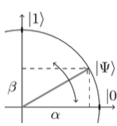
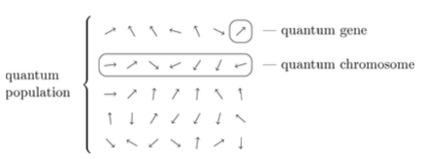
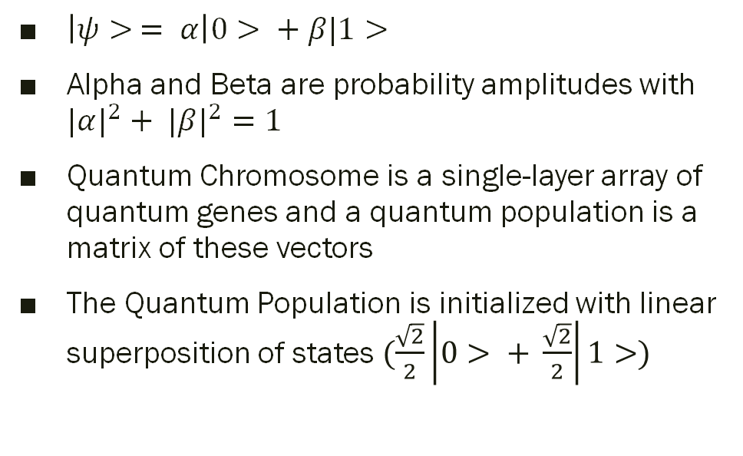
Background: Initialization of Quantum Population
$\left|ψ> = α\right|0> + β|1>$
Alpha and Beta are probability amplitudes with ${|α|}^{2}+ {|β|}^{2}=1$
Quantum Chromosome is a single-layer array of quantum genes and a quantum population is a matrix of these vectors
The Quantum Population is initialized with linear superposition of states $(\frac{\sqrt{2}}{2}\left|0> + \frac{\sqrt{2}}{2}\right|1>)$

Slide 6
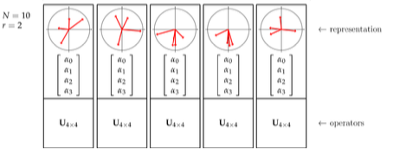
Background: Grouping into Registers
In the Quantum Population, every two qubits will be grouped into an individual quantum register to represent pairs of genes

Slide 7
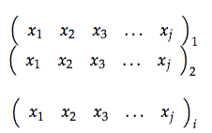
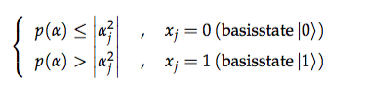
Background: Measurement of Classical Population
Qubit observation is then simulated by measuring the values of the quantum population
After measurement, a population, P(t), is obtained composed of classical chromosomes or bit strings.
These strings are then evaluated in the knapsack function to determine which string provides the greatest profit and that string is stored as b.

Slide 8
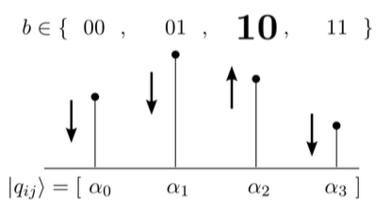
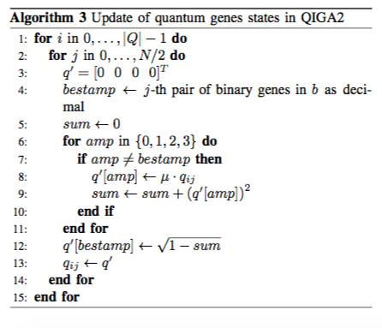
Background: Manipulating Amplitudes
After b is determined for the evolution, the amplitudes of each register are updated.
If the amplitude does not correspond to the j^{th} pair of bits in b, the amplitude is decreased by a factor of µ (approximately 0.99)

Slide 9
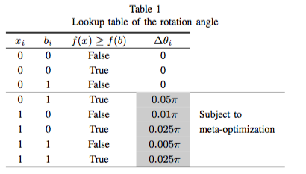
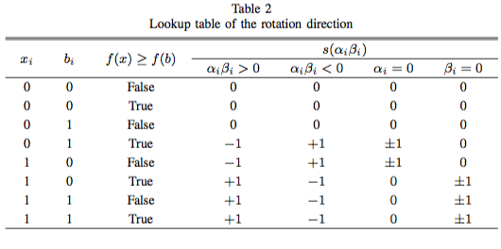
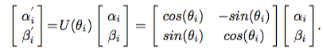
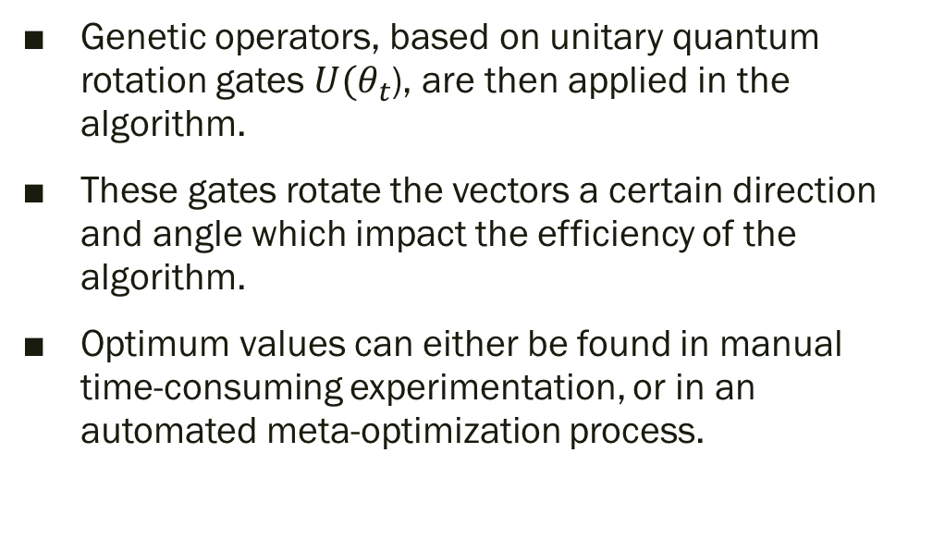
Background: Rotation Matrix
Genetic operators, based on unitary quantum rotation gates $U(θ_{t}$), are then applied in the algorithm.
These gates rotate the vectors a certain direction and angle which impact the efficiency of the algorithm.
Optimum values can either be found in manual time-consuming experimentation, or in an automated meta-optimization process.

Slide 10
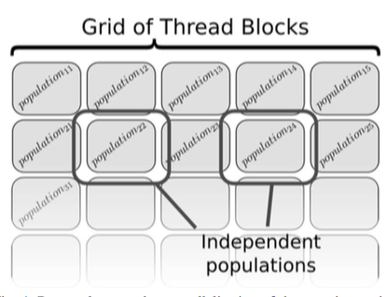
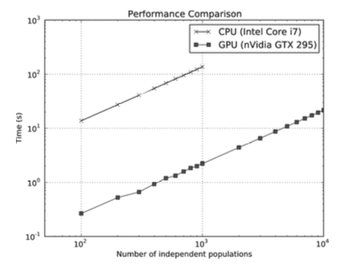
Background: Computational Restrictions

Slide 11
Background: Meta-Optimization
Two Possible definitions:
The fitness value after 5000 evaluations 500 generations for populations consisting of 10 quantum individuals) must be maximized
The number of fitness evaluations, after which a certain fitness value has been reached (1450), must be minimized
In meta-optimization, the algorithm has been tuned with respect to the first criterion and then with respect to the second. The objective was to find rotation angles that result in the best final fitness values instead of vice versa.

Slide 12
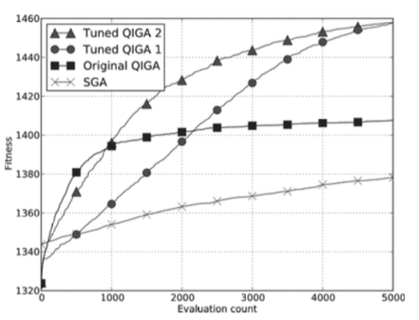
Background: Stabilization

Slide 13
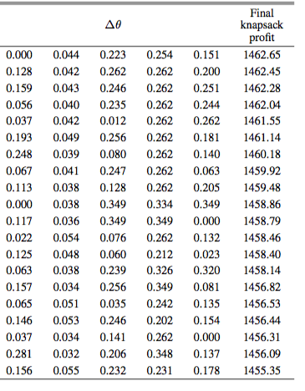
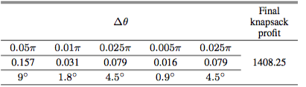
Background: Data

Slide 14
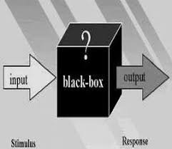
Research Question
Using two different QIGA libraries, can I implement a disaster algorithm and determine which library provides a greater optimization value for the knapsack problem?

Slide 15
Hypothesis
If I create a quantum Black-Box Function, then I will increase the optimization of the knapsack problem because the stabilization value for my function will be higher than the existing values.

Slide 16
Materials
Classical Computer
5 qubit IBM Quantum Computer
Quantum Simulator
Virtual Environment to Run Python Code

Slide 17
Skills
Knowledge of Qiskit python
Comprehensive understanding of Genetic Algorithms
Knowledge of meta-stable conditions and Disaster Algorithms
Understanding of mathematical problems requiring immense computing power

Slide 18
Procedure: Disaster Condition
After the graph of probability amplitudes for each best individual stabilizes onto an asymptote, I will employ a disaster condition, such as removing one of the quantum registers passed into the black-box function, and the algorithm will be called another 5000 times.

Slide 19
Sample Testing
Problem | Size (N) | SGA | QIGA - 1 | QIGA - 1 Tuned | QIGA - 2 | My QIGA - 2 Tuned Function
knapsack-100 | 100 | 577.71 | 578.81 | 592.82 | 596.48 | 610.49
knapsack-250 | 250 | 1387.92 | 1406.53 | 1449.91 | 1467.41 | 1510.79
knapsack-400 | 400 | 2209.92 | 2222.16 | 2284.97 | 2334.49 | 2397.3
knapsack-500 | 500 | 2803.27 | 2812.74 | 2869.77 | 2929.47 | 2986.5
knapsack-1000 | 1000 | 5451.66 | 5462.72 | 5568.23 | 5709.12 | 5814.63

Slide 20
Future Work
Improve the result of any optimization problem with a limiting factor
Knapsack problem to optimize the fuel available for space expeditions.
Predict interactions between communities

Slide 21
References
Wang, H., Liu, J., Zhi J., & Fu, C. (2013, Mar 9). The Improvement of Quantum Genetic Algorithm and Its Application on Function Optimization. Hindawi, 2013. http://dx.doi.org/10.1155/2013/730749
(2017, Aug). Dynamic Programing | Set 10 (0-1 Knapsack Problem). Geeks for Geeks. Retrieved from www.geeksforgeeks.org/knapsack-problem/
Nowotniak, R., Kucharski, J. (2014, Sept). Higher-Order Quantum-Inspired Genetic Algorithms. IEEE. doi: 10.15439/2014F99

Slide 22
References: Pictures
Black Box. Tv tropes. Retrieved from tvtropes.org/pmwiki/pmwiki.php/Main/BlackBox
Bone, S., Castro M. (n.d.). A Brief History of Quantum Computing . Retrieved from www.doc.ic.ac.uk/~nd/surprise_97/journal/vol4/spb3/
(2017, Nov 14). Quantum leap spells new age of computing. The Day. Retrieved from http://theday.co.uk/technology/quantum-leap-spells-new-age-of- computing
Trimok (2013, Dec 24). Particle in a 1-D box and the correspondence principle [Msg 1]. Message posted to physics.stackexchange.com/questions/91221/particle- in-a-1-d-box-and-the-correspondence-principle?answertab=oldest#tab-top

